Slide 1
Incident Response Plans
Casey Beaumont

Slide 2
AGENDA
Introduction
What is an IRP?
Why Do We Need One?
Roles and Responsibilities
Progressive IRP Pieces
All the Details
It’s Go Time
After Action
Moving On

Slide 3

INTRODUCTION
Casey Beaumont
@silhouette_sec
Incident Response Manager at Marsh McLennan, a global financial services firm
Forged in the fire of the defense industry
10+ years in Incident Response
Sucker for process and documentation

Slide 4
What is an IRP?

Slide 5




Incident Response Plan your place to detail your approach to Incident response so your org is prepared- in advance
Activities Required
Approach to Incident Response
Roles and Responsibilities
Contacts, Communication, and Metrics
Notes:
An Incident Response Plan, which can be extremely broad for any major incident an organization might face or specific to cyber security related incidents, is a centralized and shareable document that can be utilized to set ground rules for:
Who is involved in incident response and who are decision makers
Step by Step approach to incident response
Action items for various teams and considerations needed
Contact information to engage teams, communication requirements, and deliverables

Slide 6
Why is this important?
Develop Relationships Now
Communication is Key
Repeatable and Consistent Response
IR Is Stressful
Keep Auditors Happy
Notes:
Relationships- IRPs expose how many teams are involved in IR – IR themselves, legal, HR, privacy, business owners, IT teams, AD, Messaging… so make sure they are all on the same page and know how they may fit! Build those contacts now.
Communication is Key- during IR, management and the C-level need to be kept informed on a regular basis. Ensure that as part of documentation you understand how Incident Response Teams are communicating and if IR is a separate effort, get regular updates up to management to keep parties informed at a non-technical level.
Repeatable and Consistent – you don’t want your response quality to differ based on who is around – if something is big enough to trigger the plan, make sure you do all the steps as you don’t know how it may continue to develop
IR is stressful – During an emotional event, people may blank on what to do, who to contact, or may skip steps. An IRP provides a backbone that lets teams follow consistent steps
Auditors- Being able to show Auditors and clients that you have an IRP provides comfort about the maturity of your security program
***Give these a priority – relationships and communication. Auditors/compliance

Slide 7
Disclaimer time
There is no one way to do this
Do what is best for YOUR organization
Notes:
This can be a basic, single document, in numbered steps! If you Google IRPs, the templates you see may follow this basic structure.
If it’s a big org and you’re creating policy around it, you may want it more fleshed out.

Slide 8
How Does this Interact with Other, General IRPs?
This talk is focusing on Incident Response Plans when it comes to Cyber Incidents specifically
A general IRP may define Data versus IT Security incidents and dictate at a higher level the organization’s overall response as well as define how major incidents never involving security are handled
These IRPs are linked, developed together, and major incident response often involves both
IT Security Incident
Data Incident
A company Information System was potentially compromised with no indication that Data was compromised (e.g., malware on a workstation)
Company Data, in whatever format, was potentially compromised (e.g., employee inadvertently mis-mailing company data)
Hybrid
Notes:
While the IT security team may never hear about a Data Incident, all too often they end up hybrids. Your org may also want to implement a “significant incident” plan, which would be used where the incident has the potential to cause large-scale disruption to operations, revenue, or reputation. This involves the C-level immediately, the chair of the board of directors, and chair of the audit committee. A “stop-trade” may be issued.
These general IRPs that involve the general Incident Response team (and not in a security investigations side) may focus on items such as engaging cyber insurance, outside counsel, law enforcement, public relations, regulatory notifications, litigation risk, notice to impacted individuals, etc.
** talk about who has control in a hybrid incident. What starts in one can quickly morph into the other. This is really the business on the right

Slide 9
Roles and Responsibilities in IR bridging the gap between technical and business
“Cyber” Incident Response Team
IR Lead and Information Security Leadership
General Incident Response Team
Separate phone bridge working technical investigation
Keep management and business stakeholders off
IR Lead translates the technical updates and investigation progress into digestible content for the business
IR Lead and/or a separate scribe role are the single point of truth
Leadership can carry updates to senior management
Business-level handling of legal, privacy, continuity, client relationships, etc.
Briefing of the C-level, with the CISO providing representation for security
Notes:
In a Hybrid incident, which tends to be most of the big ones, how do the venn diagrams overlap? We see the IT security side of the house, but IT Security is one piece of the larger Incident Response Team, represented by the CISO typically.
The IR team must have a designated IR leader, and ideally a second dedicated scribe. This team performs the following roles:
1. Coordinates the standup of Incident Response, notifying appropriate parties (which may engage the general IRT) which may include third party IR firm
2. Directing response activities
3. Documenting initial event and all subsequent investigation, tracking hosts, timelining
4. Writing status briefings at different technical levels to pass up through management to the IRT to speak to the investigation thus far
IR Lead manages the technical bridge regardless of who else is on there.

Slide 10
So What’s it look like?

Slide 11
Pieces of a progressive IRP
Policy
Big picture company policy on Incident Response
Process
Flow of events and all steps taken in a typical response
Playbooks
For IR and shareable to related teams to security – much more detailed
Procedures
The nitty gritty on how to perform specific tasks, which supplement playbooks
Notes:
Talk about what’s appropriate to share
Policy and process should be sharable****
We don’t share procedures

Slide 12
IR Policy
Pick a Guideline to Follow
Lay Out The Ground Rules
Define Roles and Responsibilities
NIST SP 800-53 Rev 5 “Security and Privacy Controls for Federal Information Systems and Organizations”
NIST SP 800-61 Rev 2 “Computer Security Incident Handling Guide”
ISO/IEC 27001
What is the company responsible to do?
Define terms and severity levels
Differentiates between cyber and data incidents
Both in security and supporting teams
Define how incidents are reported
Notes:
It’s ok to rip whole sections out of there- our policy is straight out of section 3.8 Incident Response and modified to fit the organization
Other guidelines- UK guideline, ISO, specify that we like NIST

Slide 13
IR policy – Copy + Paste
IR-8 INCIDENT RESPONSE PLAN
Develop an incident response plan that:
Provides the organization with a roadmap for implementing its incident response capability;
Describes the structure and organization of the incident response capability;
Provides a high-level approach for how the incident response capability fits into the overall organization;
Meets the unique requirements of the organization, which relate to mission, size, structure, and functions;
Defines reportable incidents;
Provides metrics for measuring the incident response capability within the organization;
Defines the resources and management support needed to effectively maintain and mature an incident response capability;
Addresses the sharing of incident information;
Is reviewed and approved by [Assignment: organization-defined personnel or roles] [Assignment: organization-defined frequency]; and
Explicitly designates responsibility for incident response to [Assignment: organization defined entities, personnel, or roles].
Distribute copies of the incident response plan to [Assignment: organization-defined incident response personnel (identified by name and/or by role) and organizational elements];
Update the incident response plan to address system and organizational changes or problems encountered during plan implementation, execution, or testing;
Communicate incident response plan changes to [Assignment: organization-defined incident response personnel (identified by name and/or by role) and organizational elements]; and
Protect the incident response plan from unauthorized disclosure and modification.
Notes:
Lot of text, but take what’s in NIST and stick it right in policy with minor modifications so your org must stick to it! Don’t feel like you have to reinvent the wheel
It’s a framework- you don’t have to take it 100% at face value, or use every single piece. Adjust to your maturity level and capabilities

Slide 14
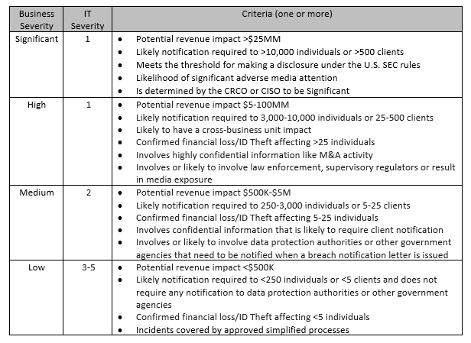
IR Policy - classification
Standardize Severity Levels
Severity classification may differ depending on the team – ensure that Legal’s definitions match those for Information Technology!
Notes:
This is going to be customized to your business and industry and is hard to define. This is not an IT discussion but a business discussion- this often happens at the general IRP level not in the IT security side
Not exact science- sometimes something that affects LESS machines can cause you SIGNIFICANT impact depending on what they hit.

Slide 15




IR Process Most similar to a single-document IRP
Standardized Definitions
Define Incident Lifecycle
Detailed Flowcharts
Metrics and Storage
Notes:
If you’re looking at templates for an IRP but want to fold into a process, here is the place to get into more detail.
Ensure that terms are being sourced from the same place so there is consistency in discussing with other teams
Define the standardized way you’re going to view the incident lifecycle
Create flowcharts to show how incidents get reported, evaluated, and processed. Each flowchart shape should be defined out, and if those pieces fall to other teams link to the proper documentation
Define what data is collected, where it is stored, and retention policy

Slide 16

Define terms for everyone
Remember – audience for IR is wider than technical teams. Get everyone speaking the same language
Does everyone know the difference between different types of threats?
Describe impact – CIA triangle and business impact (financial, legal, customer, company image)
“Terms contained within this document are standard international terms used for information security. For general definitions see NIST IR 7298, Rev 2 - Glossary of Key Information Security Terms (http://nvlpubs.nist.gov/nistpubs/ir/2013/NIST.IR.7298r2.pdf)”
Notes:
This is going to really differ between technical and nontechnical teams if you don’t STANDARDIZE
**Cover me – difference in interpretations
“breach”
IR lead act as the bridge between technical and non-technical

Slide 17
Define incident lifecycle
Prepare
Detect
Analyze
Contain
Eradicate
Recover
Post-Incident Activity
Prepare – training, required access and resources
Detect – define entry points for security events
Analyze – define handoff between teams
Contain – considerations between business and safety
Eradicate – reimage vs eliminating artifacts
Recover – restore the business
Post-Incident – after-actions report
In the technical part of investigation, you’re going to hit some of these multiple times!
Notes:
Adjust Response

Slide 18
Who doesn’t love a flowchart
Each square or decision point gets numbered and then expanded upon in text
Nice visual view of the process and may point towards other documentation like playbooks with more specific flows

Slide 19
Where is this getting stored?
Ticketing
Main ticketing system
General tracking
Restricted Access
Point to further locked down repository
Privileged and Confidential
Further Encryption
Major IR might be Read-In Only
Stored Docs with Additional Protection
May be exposed to other colleagues
Define a retention period
Plan for legal holds
Standardize naming convention for records
Notes:
What is your system of record? Who can look up information there?
Ideally, you’d have a ticketing system that has privacy for security related events- you can’t exactly put sensitive data in something that analysts can search for easily.
Store the sensitive bits somewhere you can control, but a tracking ticket is still necessary for metrics. Inside, point to the actual repository.
If something is significant or had a “need-to-know” level of access, further encryption may be required to protect the data.

Slide 20
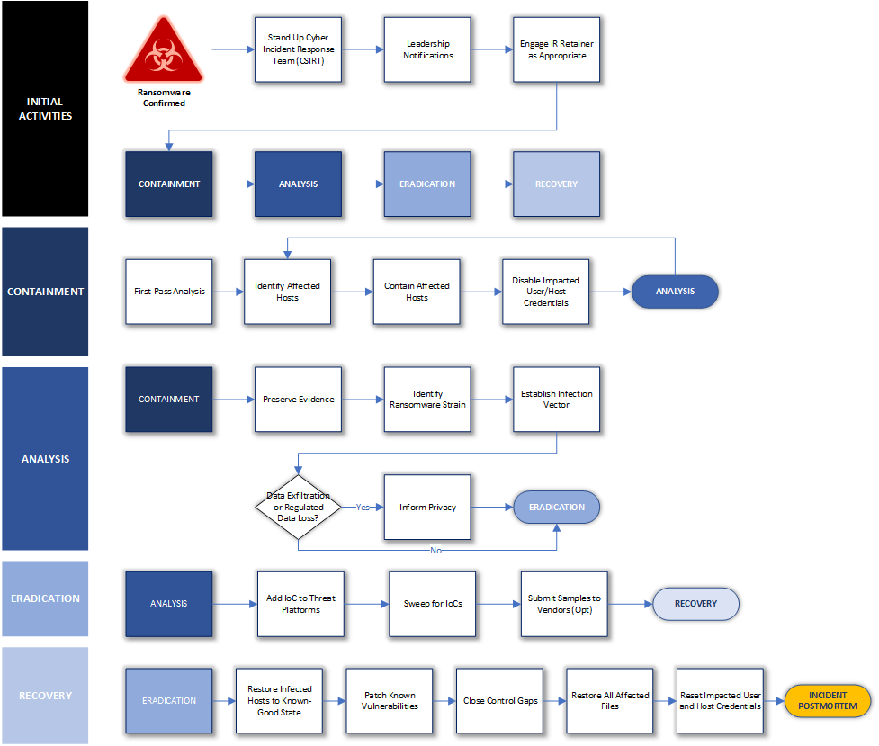
Playbooks
Augments the Policy and Process, but gets into the specifics
Start with a broader one that is adaptable to many situations – like “Ransomware”
Flowchart to get the major steps down, then detail how each is carried out
Refer to different teams who make different decisions
Notes:
In drafting a “general” incident playbook I found that ransomware is both a common threat and generally applicable to major IR- just skip steps not necessary or augment as necessary in the moment
This one is broken down by lifecycle step-
Initial activities (standing up CIRT, notifications, retainer)
Containment (analysis, identifying hosts, containing them, disabling accounts etc., repeat)
Analysis (preserving evidence, threat intelligence, determining infection vector, determining data exfil or loss)
Eradication (adding IoC’s to detection platforms, sweeping for more, submitting to vendors)
Recovery (reimaging, patching, closing control gaps, restoring files, reset creds, return business to normal)

Slide 21
What should we Playbook?
If you find yourself sweating when considering what IR in a certain circumstance would look like, it needs a playbook
Cloud IR
Phishing / Business Email Compromise
Ransomware
Threat Intelligence / Major Vulnerability Lifecycle
SaaS Breaches
Data Exposures
Containers
DDOS
Vendor Breaches
Notes:
Are you comfortable when someone mentions the idea of what happens when you realize you have a breach of your AWS? Oracle Cloud? Docker?
Do you know how you’d handle business email compromise, which is where a client (typically) without MFA on their email gets compromised and someone inserts themselves as a third party to divert funds?
Do you know how you’d approach vendor or supply chain compromises? What questions do you ask them?

Slide 22
Procedures
Don’t Rely On What Is In People’s Heads
Standardized Log Collection
How to Pull Email
URL Analysis
How to Contain a System
Static and Dynamic Analysis of a File
Onboarding New IR Team Members
IR Standup
Disabling Credentials
Locating People and Assets
Eliminate single points of failure – DOCUMENT how things are done!
Notes:
IR stress makes people forget things
Benefits to new hires and upskilling people
If someone quits or is on vacation, did you just loose capability?

Slide 23
It’s 2 am and the phone rings

Slide 24

How does this play out?
On a long-enough timeline, we all get popped
Worst case scenario:
Someone’s already got your data and has told you so
You don’t have a playbook for this yet
What DOES your current IRP give you?
Every situation is unique so you may need to improvise from your IRP
Improvise – Adapt - Overcome
Notes:
So worst case scenario- something you hadn’t thought of yet happens. Does your IRP give you the bare bones you need to get the right people on the phone and able to investigate this properly?
You want to feel so on top of it that if you’re engaging a third-party IR firm that you’re able to be ahead of providing them the data they need, investigating along with them, and having them as a third party confirming your notes.
There is ALWAYS going to be some new twist- had you known what an attacker could do you would have hardened it already! You still need GOOD people and GOOD logging to allow them to make the connections and tell the whole story.
With a proper IRP though, the different teams can work in lockstep and make informed decisions quickly to minimize pain.
**even in a best case scenario you may need to improvise from your playbook – improvise, adapt, overcome

Slide 25
After Action

Slide 26

After Action
We did it and kept our jobs too!
Hold on- don’t repress this yet!
Document:
Background
Actions Taken
Response Review
What was Successful?
What Can Be Improved?
Any Recommendations to the Business?
Notes:
**As you document, be noting items for AAR
IR events are stressful, but you have to be prepared for the next IR immediately following. Staged closing of the current incident so you can refresh but still be ready for another IR

Slide 27

Document those changes
Get Sign-Off From Stakeholders
Process Improvements
Emergency vs. Proactive Changes
If you don’t have written agreement to fix something, it’s NOT GOING TO HAPPEN
Agree on timelines
May want to loop in Legal/Management
Determine who has accountability
How did your IRP let you down?
What information were you missing?
What stumbling blocks did you encounter?
Close the exposures used by an attacker in real-time
Identify weaknesses that were exploited that may need planning to close
Track those changes that may incur time and cost
Notes:
In your after action you might come up with recommendations. However, you can’t just say “do this” but hand it off to only your management who fully may drop the ball on having it happen. You need to get SIGN OFF from the person performing the action.
In our org, this may need agreement from management, the owner, and possibly legal if needed. Define in your org who is responsible for checking in and making sure this gets completed.
Every major IR is a perfect opportunity to detect failures in your IRP, playbooks, and procedures and IMPROVE. Define what may need adding! Refine what might be out of date!
In major IR, you’re going to be closing holes in real time, and ensure you document those. But it may prompt wider spread changes (and checking where else you may have similar vulns) and those should be owned by the business.
** Point back to recovery- take corrective actions, tough when time+money are involved

Slide 28

Archive and move on
Having an IRP in place should have gotten you some wins, and kept more people happy about your response
Faster time to inform relevant parties
Faster and more consistent analysis and response
Happier teams with more cross-communication
Decision making responsibilities spelled out in advance
However, move on- the next one could be just around the corner
Notes:
Unfortunately, IR is an ever-evolving beast, and you’ve probably had day to day incidents alongside this major one. When you can, wrap it up neatly and move on!
**you might have another big one, or an overlapping big one

Slide 29
THANK YOU and may the odds be ever In your favor
Casey Beaumont
@silhouette_sec
Casey.L.Beaumont@mmc.com
https://github.com/silhouettesec/IncidentResponsePlans
Notes:
**add github

